Slide 1
2022 VLDB Endowment Awards
Session chair:
Chris Jermaine, Rice University

Slide 2
VLDB Endowment Awards
3 Awards, given annually:
VLDB Early Career Research Contribution Award
VLDB Women in Database Research Award
VLDB Test of Time Award

Slide 3
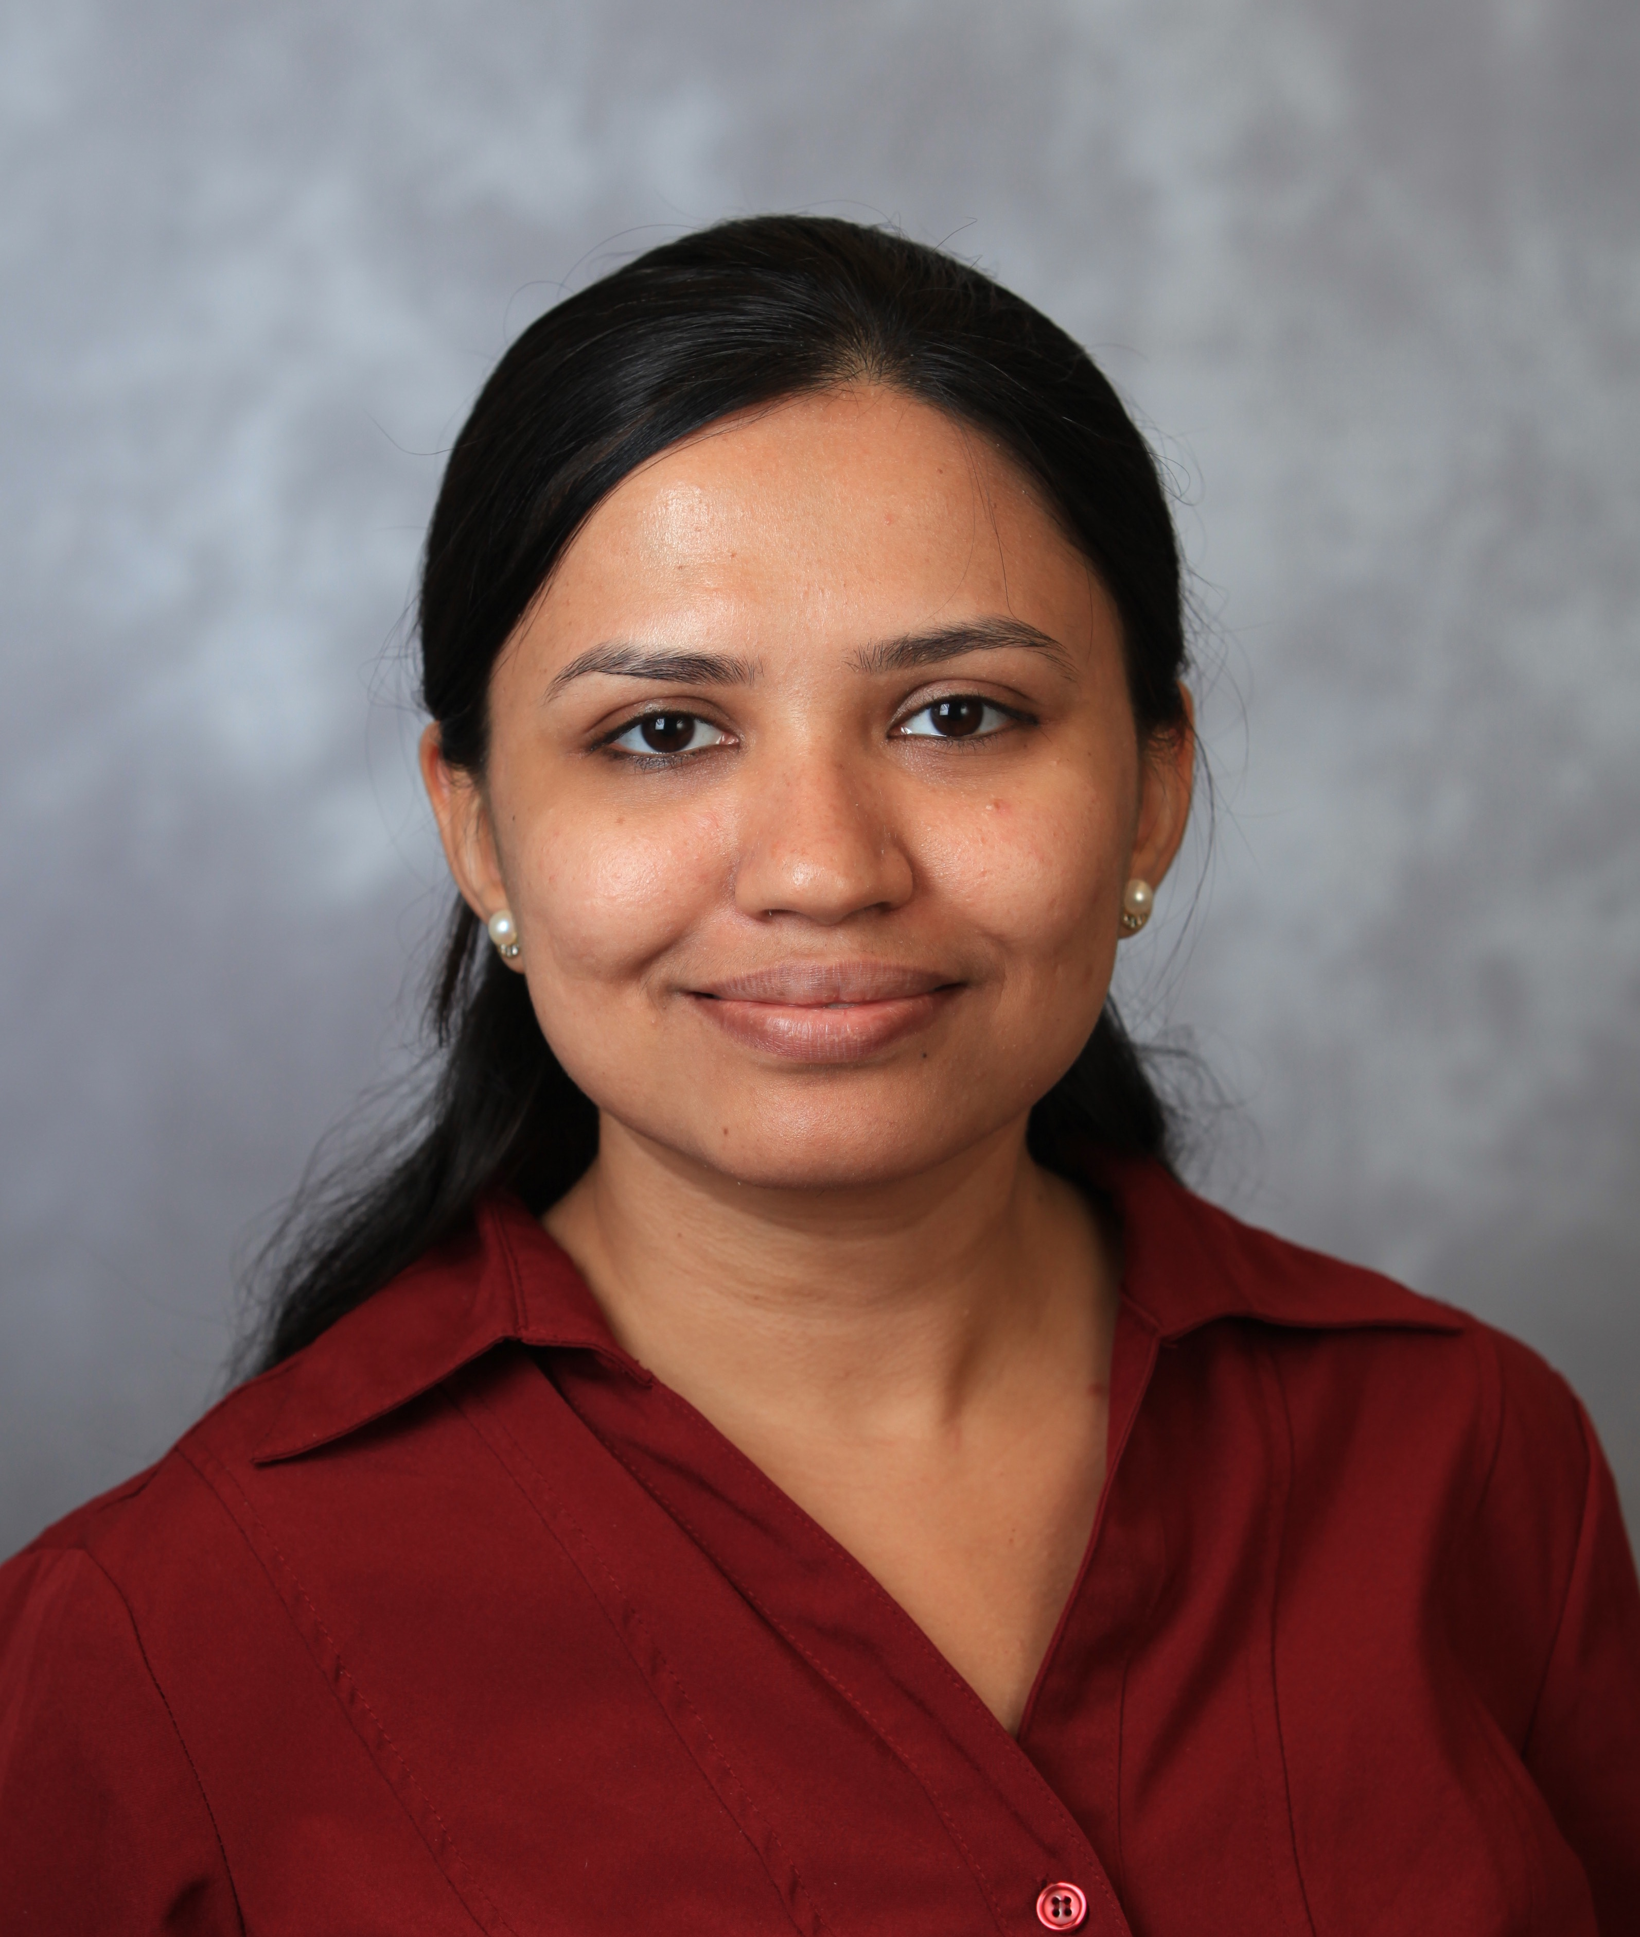
VLDB Endowment Awards
3 Awards, given annually:
VLDB Early Career Research Contribution Award
VLDB Women in Database Research Award
VLDB Test of Time Award
Sudeepa Roy
Yizhou Sun, Jiawei Han, Xifeng Yan, Philip S. Yu, Tianyi Wu
PathSim: Meta Path-Based Top-K Similarity Search in Heterogeneous Information Networks. Proc. VLDB Endow. 4(11): 992-1003 (2011)
Fatma Ozcan

Slide 4
VLDB Endowment Awards
2022 Awards Committee
Anastasia Ailamaki
Peter Haas
Chris Jermaine (Chair)
Tova Milo
Xiaofang Zhou
For more information, visit https://www.vldb.org/awards.html

Slide 5
VLDB Endowment Awards
Reminder: we can’t have top-notch awardees…
…without top-notch nominations!!
Do your duty… nominations are an important service to the community
As important as reviewing papers, organizing conferences
Call out around April 1, nominations due around June 1

Slide 6
VLDB Endowment Awards
Remember, the committee has a memory
We don’t discard competitive nominations (though we may ask for updates)
Nominees from year X often win in year X + n for small n
So it’s important to get the best people from our community into the nominee pool

Slide 7
Early Career Award
2022 VLDB Early Career Research Contribution Award
The award recognizes a researcher who has demonstrated research impact through a specific technical contribution of high significance since completing the Ph.D.
2021 Winner: Andy Pavlo
2020 Winner: Meihui Zhang
2019 Winner: Aditya Parameswaran
2018 Winner: Tim Kraska
2017 Winner: Guoling Li
…
Cash prize of $2000!

Slide 8
Early Career Award
2022 VLDB Early Career Research Contribution Award
Winner: Sudeepa Roy
“For her work on helping users to understand query results, and on generating explanations for the computations that lead to them.”

Slide 9
Women in Database Research Award
2022 VLDB Women in Database Research Award
This award recognizes a woman researcher who has made significant technical contributions to the field.
2021 Winner: Susan Davidson
2020 Winner: Anastasia Ailamaki
2019 Winner: Wang-Chiew Tan
2018 Winner: Renee Miller
2017 Winner: Tova Milo
2016 Winner: Magdalena Balazinska
Cash prize of $2000!

Slide 10
Women in Database Research Award
2022 VLDB Women in Database Research Award
This award recognizes a woman researcher who has made significant technical contributions to the field.
Winner: Fatma Ozcan
“For two decades of research in query languages and query processing, and her development of new technologies that have had significant impact on widely-used data management products”

Slide 11
2022 VLDB Test of Time Award
A paper is selected from the VLDB Proceedings 10 to 12 years ago […] that best meets the "test of time.” […] The committee especially values impact of the paper in practice (e.g., in products and services). Impact on the academic community […] is also valued.

Slide 12
2022 VLDB Test of Time Award
A paper is selected from the VLDB Proceedings 10 to 12 years ago […] that best meets the "test of time.” […] The committee especially values impact of the paper in practice (e.g., in products and services). Impact on the academic community […] is also valued.
Yizhou Sun, Jiawei Han, Xifeng Yan, Philip S. Yu, Tianyi Wu
PathSim: Meta Path-Based Top-K Similarity Search in Heterogeneous Information Networks. Proc. VLDB Endow. 4(11): 992-1003 (2011)

